Slide 1
File System Implementation

Slide 2
File System Implementation
File-System Structure
File-System Implementation
Directory Implementation
Allocation Methods
Free-Space Management
Efficiency and Performance

Slide 3
File-System Structure
File structure
  Logical storage unit
  Collection of related information
File system resides on secondary storage (disks)
File system organized into layers
File control block – storage structure consisting of information about a file

Slide 4
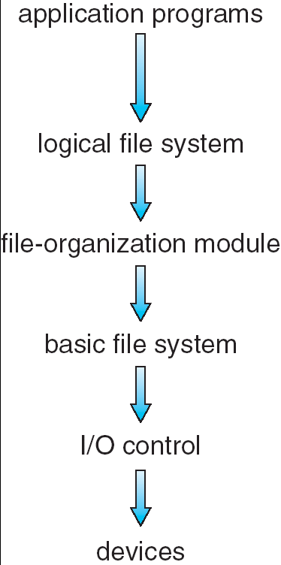
Layered File System
File organization module :
It consist of information about Files and their logical blocks And physical blocks . And it Perform translate logical block To physical blocks. It also include free
Space management
Logical file system :
Information about files
It also responsible for
Protection and security
Basic file system :issues
Generic commands to device
Drivers read or write physical
Blocks on the disk
I/O control : consist of
Device drivers and interrupt
Handler to transfer information
Between memory and disk

Slide 5
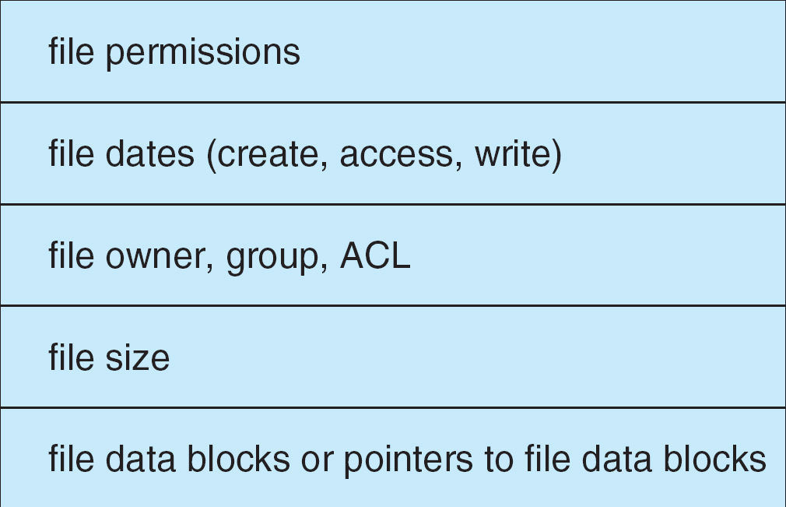
A Typical File Control Block

Slide 6
In-Memory File System Structures
The following figure illustrates the necessary file system structures provided by the operating systems.
Figure 12-3(a) refers to opening a file.
Figure 12-3(b) refers to reading a file.

Slide 7

In-Memory File System Structures

Slide 8
File system
Unix file system structure (UFS)
Disk drive
Partition
partition
partition
File system
i-list
Directory block and data blocks
Boot block
Super block
i-node
i-node
i-node
i-node

Slide 9
i-list
Directory
block
Directory
block
i-node
0
i-node
1267
i-node
2549
2549
.
1267
..
1267
.
i-node
..
2549
testdir

Slide 10
Process table
File table
V-node table
fd flag
ptr
V-node
information
File status flag
Current file offset
V-node ptr
i-node
information
Current file size
Process table
fd flag
ptr
File status flag
Current file offset
V-node ptr

Slide 11
File table
V-node table
Process table
File status flag
V-node
information
fd flag
ptr
Current file offset
V-node ptr
i-node
information
Current file size

Slide 12
Virtual File Systems
Virtual File Systems (VFS) provide an object-oriented way of implementing file systems.
VFS allows the same system call interface (the API) to be used for different types of file systems.
The API is to the VFS interface, rather than any specific type of file system.

Slide 13

Schematic View of Virtual File System

Slide 14
Allocation Methods
An allocation method refers to how disk blocks are allocated for files:
Contiguous allocation
Linked allocation
Indexed allocation

Slide 15
Contiguous Allocation
Each file occupies a set of contiguous blocks on the disk
Simple – only starting location (block #) and length (number of blocks) are required
Random access
Wasteful of space (dynamic storage-allocation problem)
Files cannot grow

Slide 16

Contiguous Allocation of Disk Space

Slide 17
Linked Allocation
Each file is a linked list of disk blocks: blocks may be scattered anywhere on the disk.
Simple – need only starting address
Free-space management system – no waste of space
No random access
block =
pointer

Slide 18

Linked Allocation

Slide 19

File-Allocation Table

Slide 20
Indexed Allocation
Brings all pointers together into the index block.
Logical view.
index table
Need index table
Random access
Dynamic access without external fragmentation, but have overhead of index block.

Slide 21

Example of Indexed Allocation

Slide 22
Free-Space Management
Bit vector (n blocks or set of bits)
0
1
2
n-1
…
0 ⇒ block[i] free
1 ⇒ block[i] occupied
bit[i] =

Each block is represented by 1 bit . If the block is free , the bit is 1 . If the
Block is allocated the bit is 0

Slide 23

Free-Space Management
Linked list :another approach to free space management is to link together all the free disk blocks, keeping pointer to he first free blocks in a special location on the disk and caching it in memory

Slide 24
Grouping
A modification of the linked list approach is to store the address of n free blocks in the first free blocks. The first n-1 of these blocks are actually free . The last block contain the address of the another
n free blocks and so on

Slide 25
Counting
This algorithm maintain the address of the first free block and the number of n free contiguous blocks that follow the first block
Each entry in the free-space list then consist of a disk address and a count

Slide 26
Efficiency and Performance
Efficiency dependent on:
  disk allocation and directory algorithms
  types of data kept in file’s directory entry
Performance
  disk cache – separate section of main memory for frequently used blocks
  free-behind and read-ahead – techniques to optimize sequential access
  free-behind : Free-behind removes a block from buffers as soon as the next block is requested
  read-ahead : A requested block and several subsequent blocks are read and cached .
  improve PC performance by dedicating section of memory as virtual disk, or RAM disk

Slide 27
End of Chapter

